Slide 1
Message Brokers

Slide 2
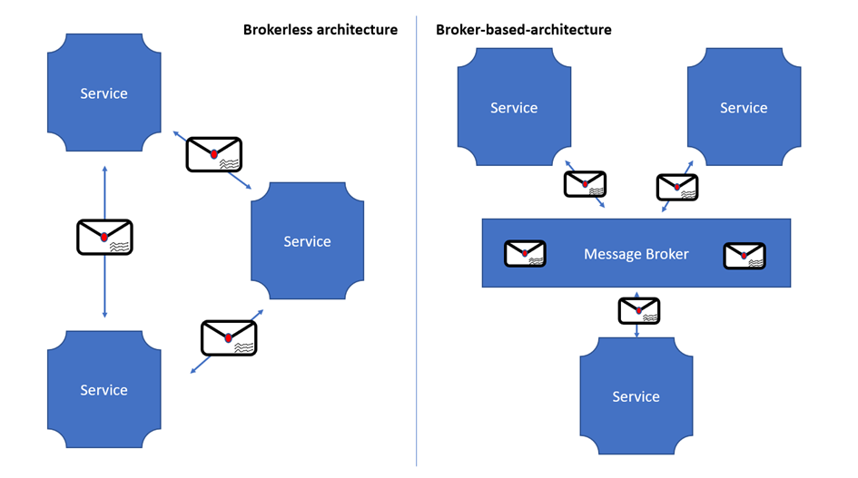
Architecture

Slide 3
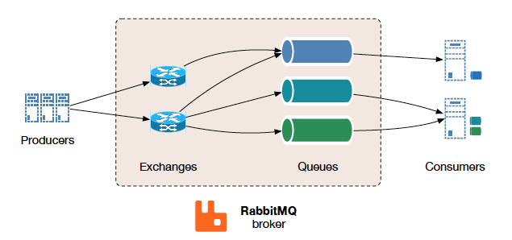
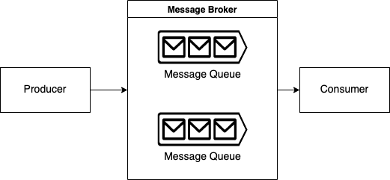
Broker Architecture

Slide 4
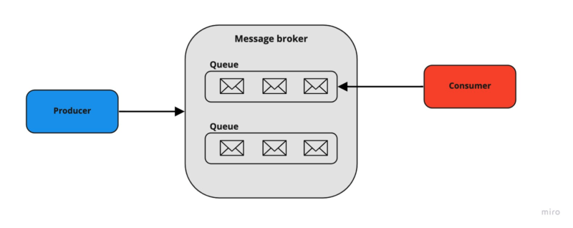
Point-to-Point Messaging

Slide 5
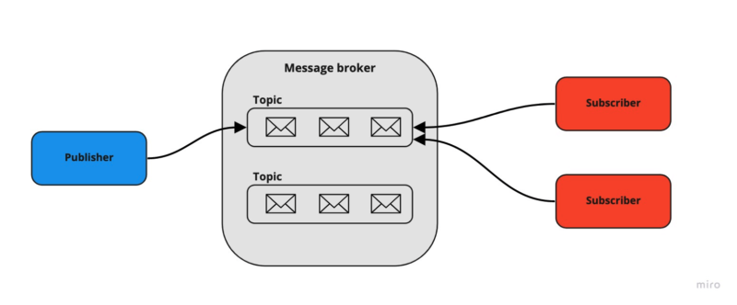
Publish/Subscribe Messaging

Slide 6
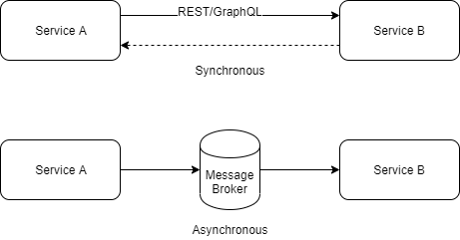
REST & Brokers

Slide 7
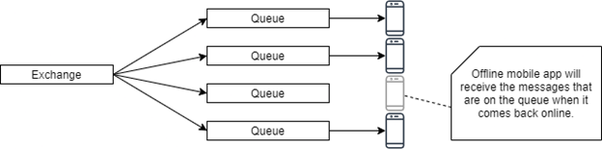
Mobile Program

Slide 8
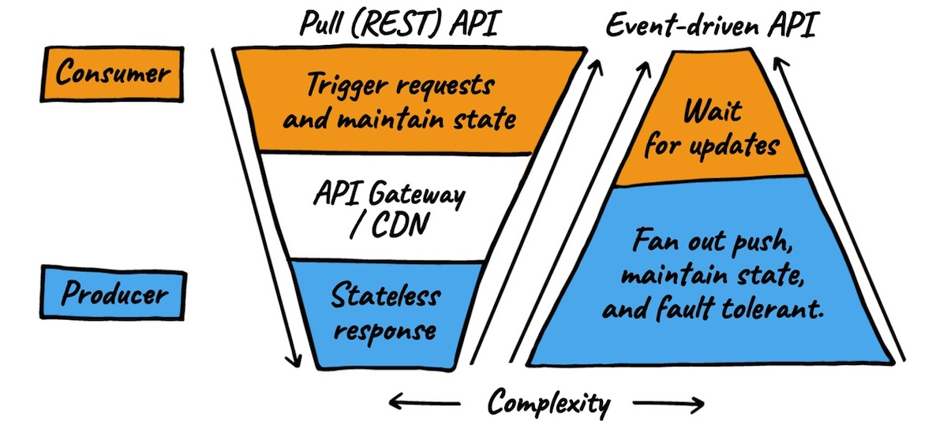
Complexity Inversion

Slide 9
Downsides
Complexity
Brokers
Learning Curve
Debugging

Slide 10

TYFYT

